Slide 1
Hotel Booking and Cancelation
File created on: 9/27/2024 2:19:34 PM

Slide 2
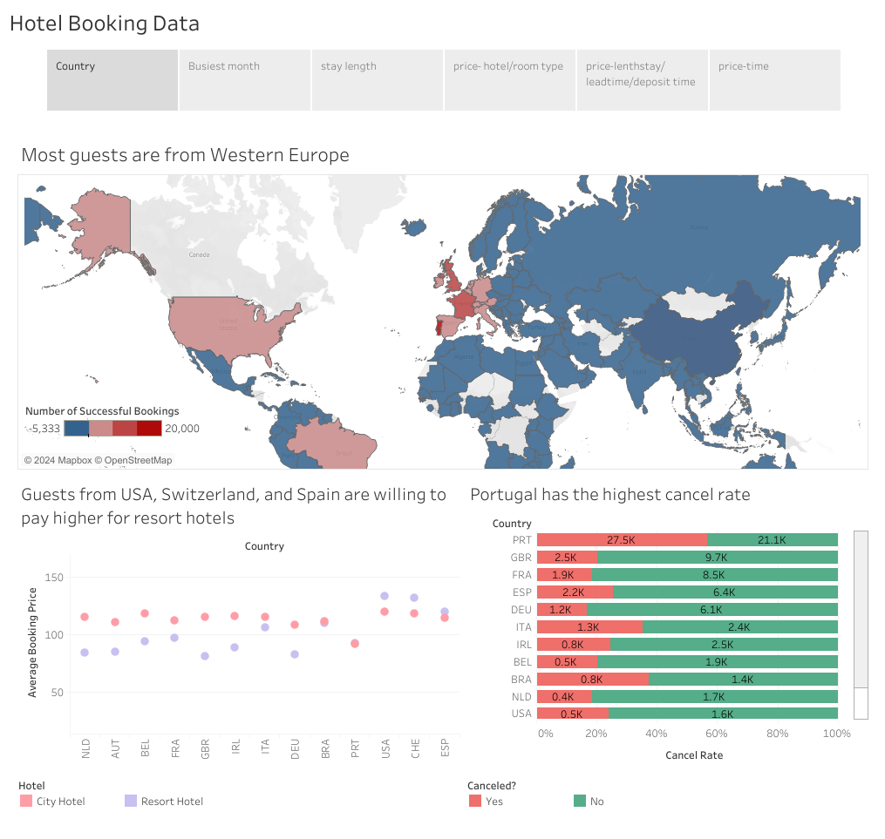

Slide 3
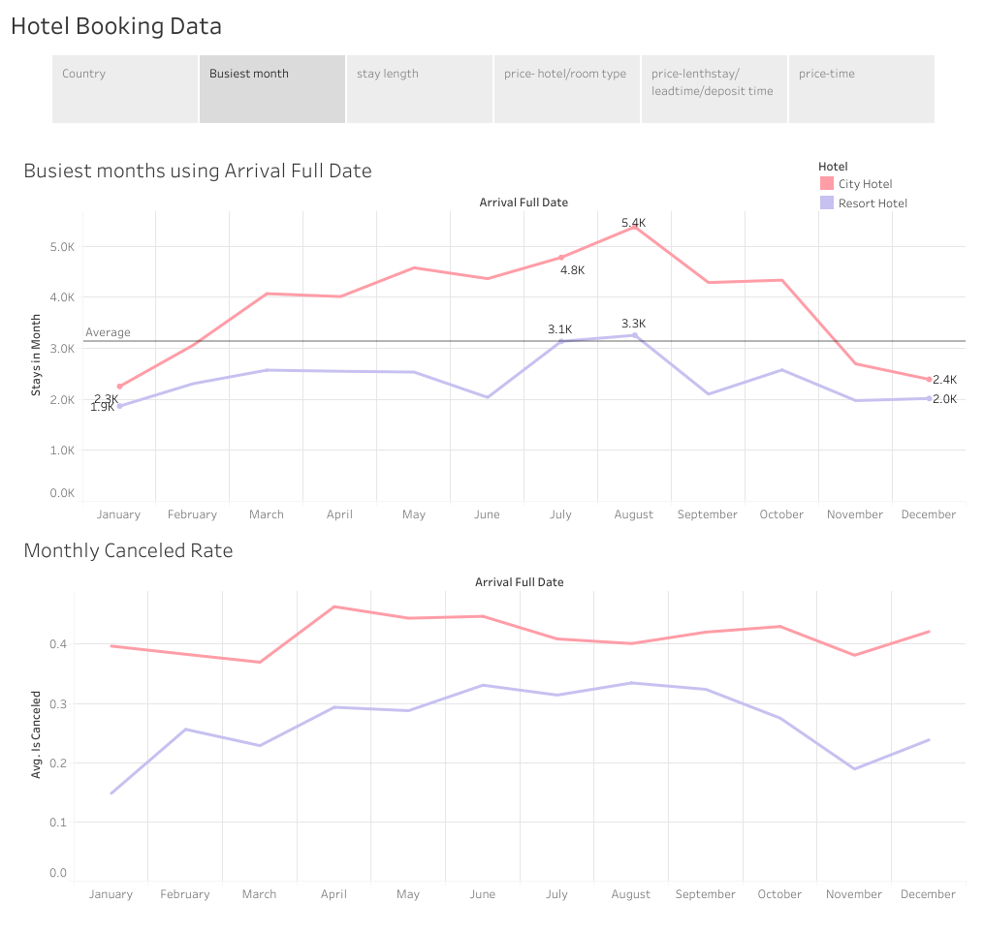

Slide 4
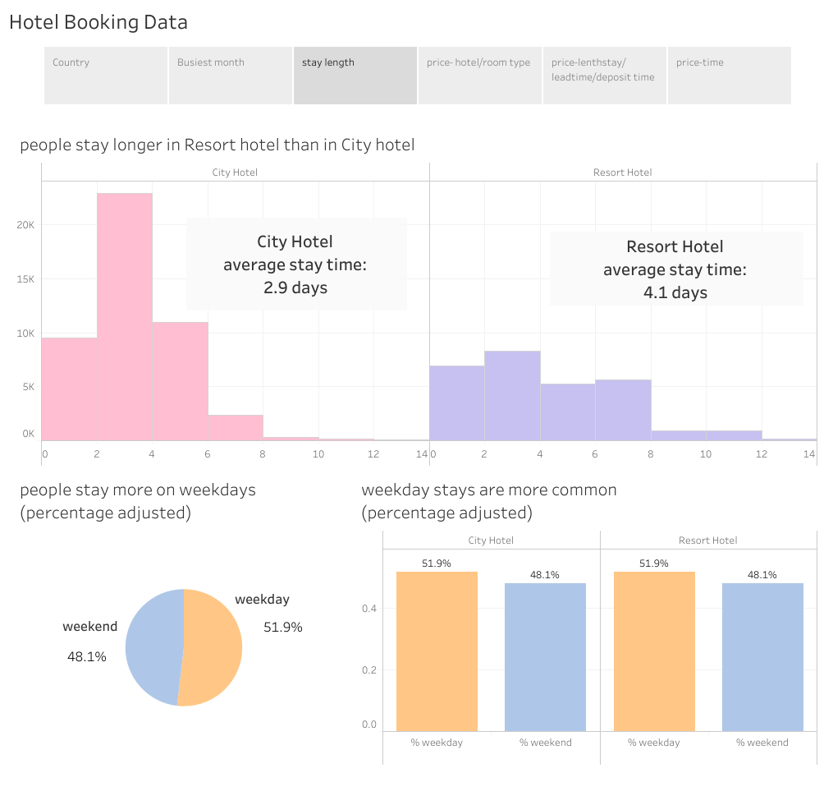

Slide 5
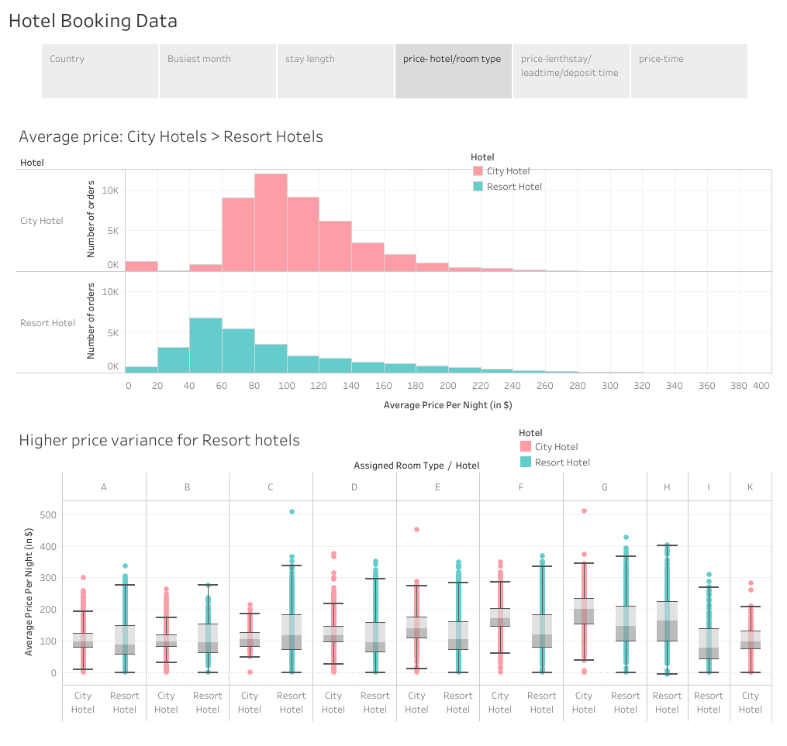

Slide 6
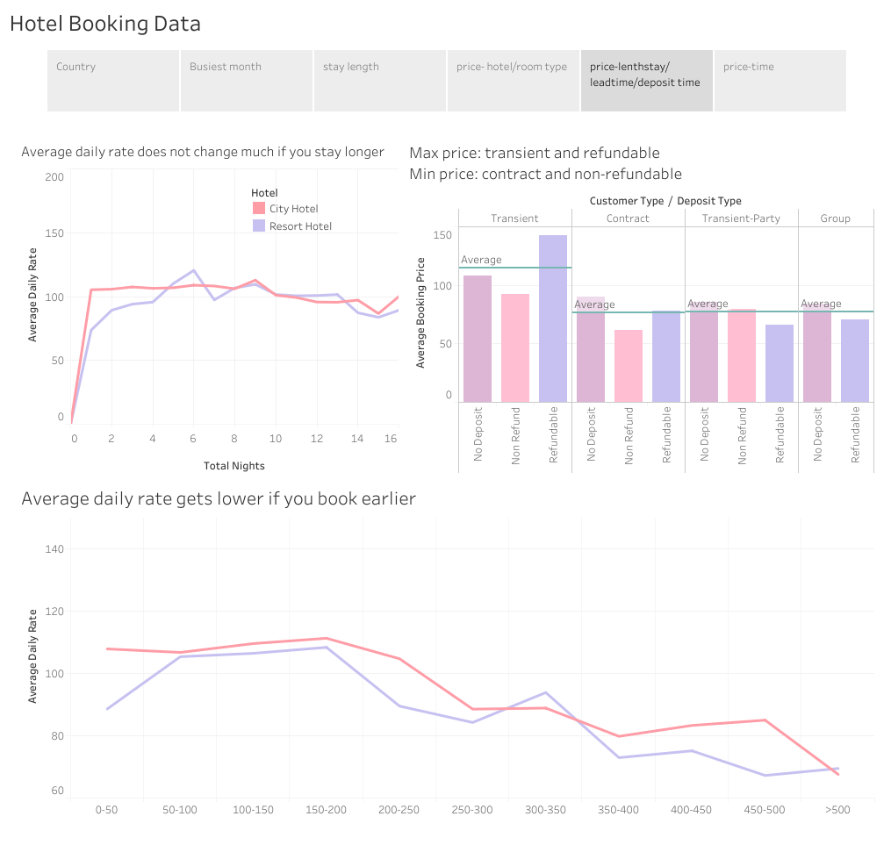

Slide 7
